Slide 1
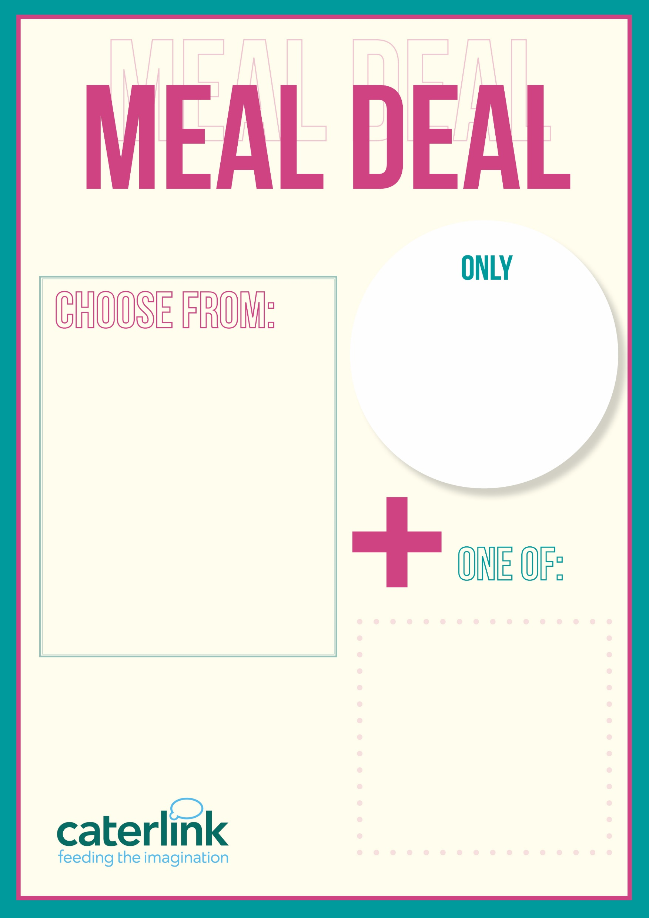
£2.80
ANY MAIN MEAL & VEGETABLES or SALAD • PASTA POT, SAUCE & SALAD • SALAD BOX • HANDMADE SANDWICH BAGUETTE/ROLL
DESSERT OF THE DAY • FRUIT JELLY • 125ml FRUIT JUICE • PIECE OF FRUIT • BOTTLE OF WATER

